Slide 1









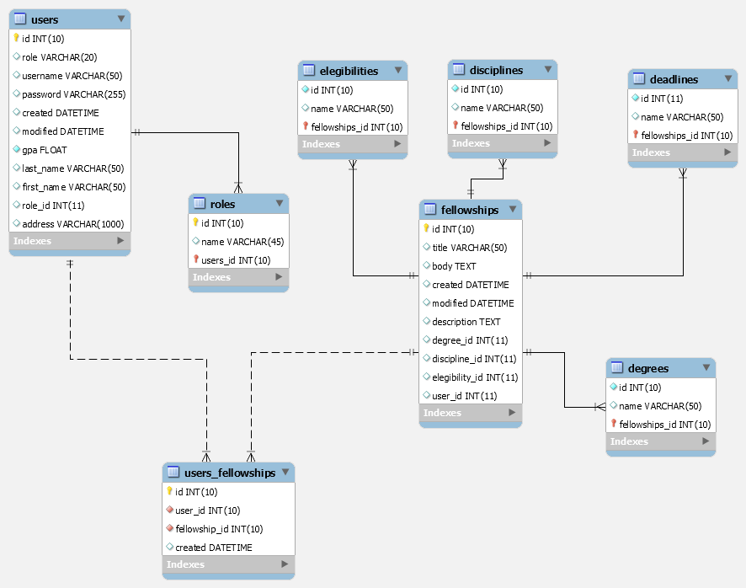
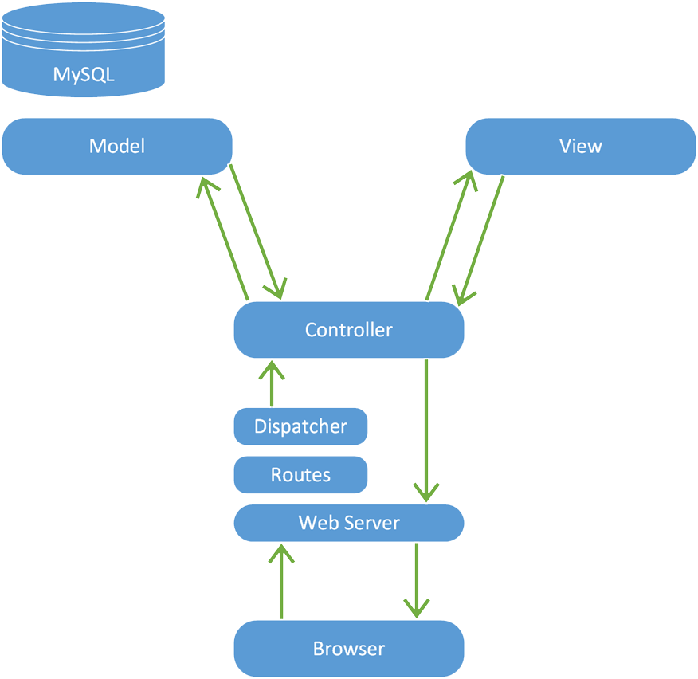
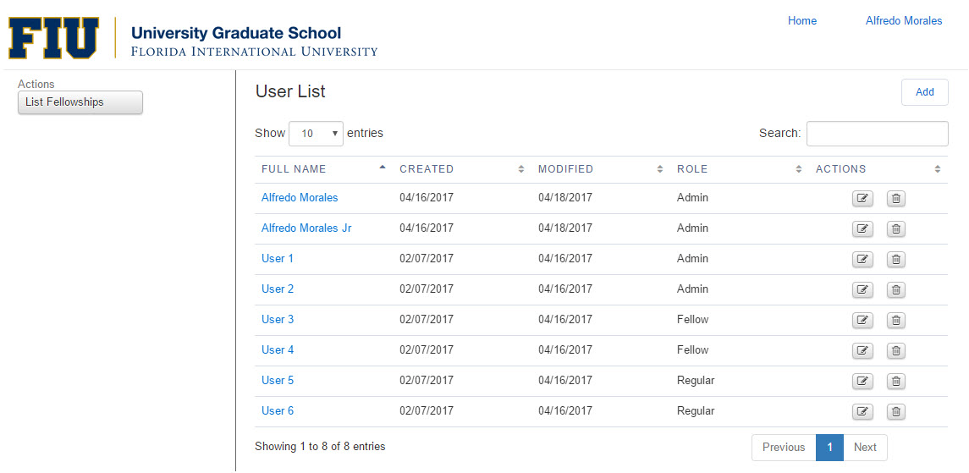


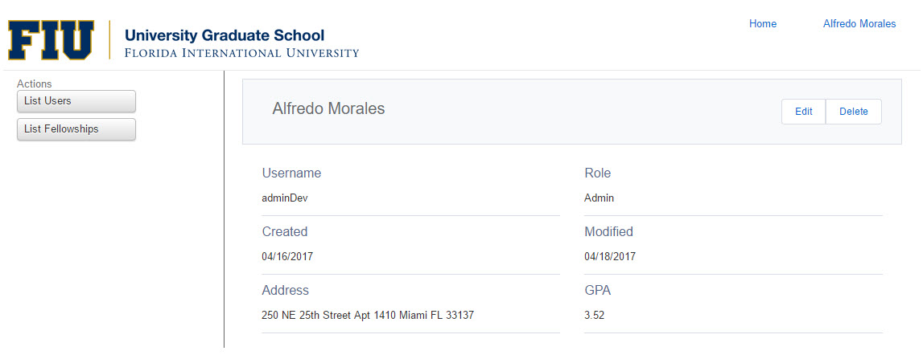
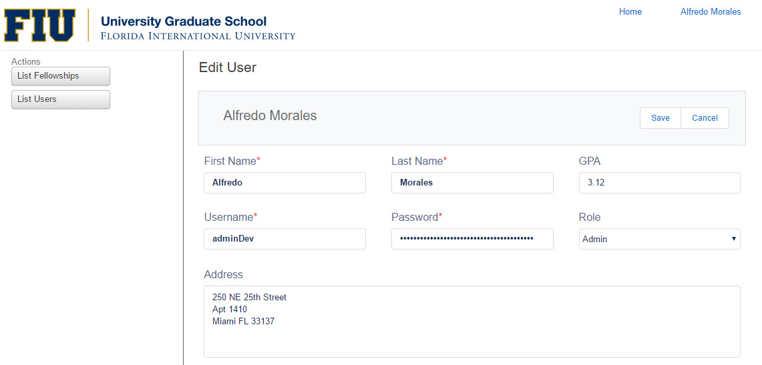

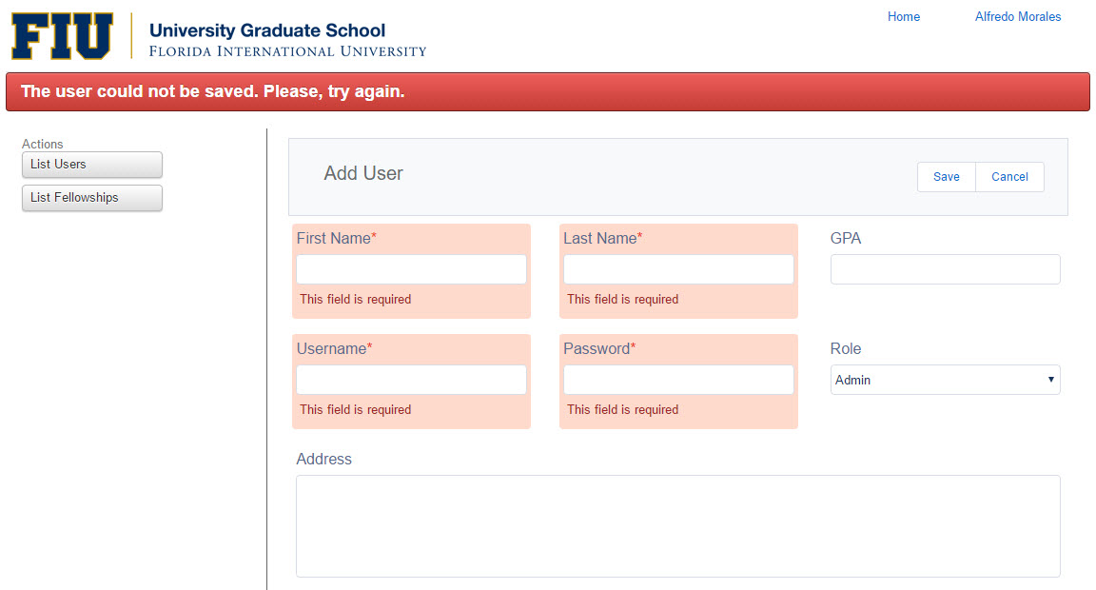
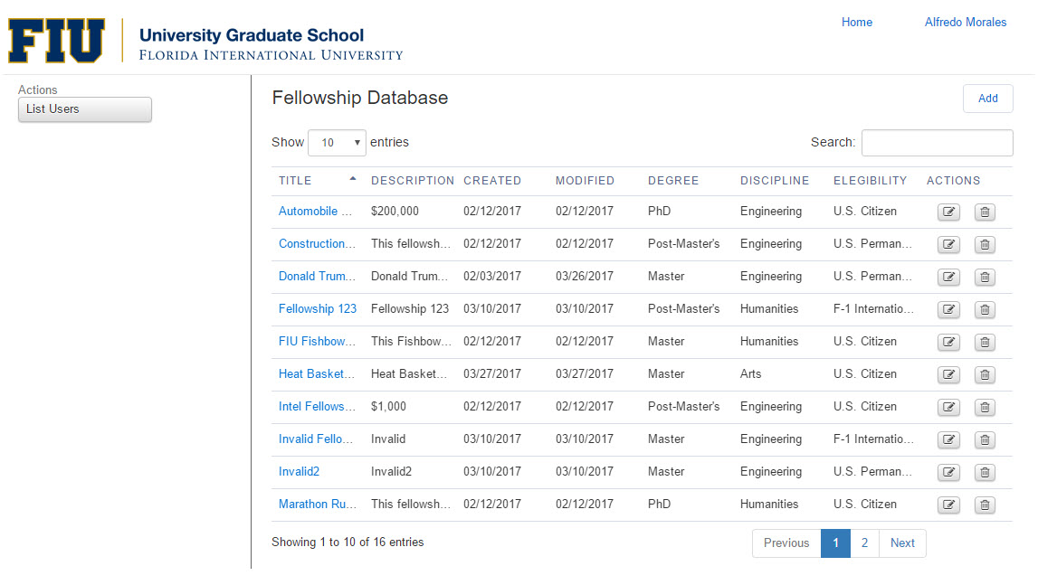
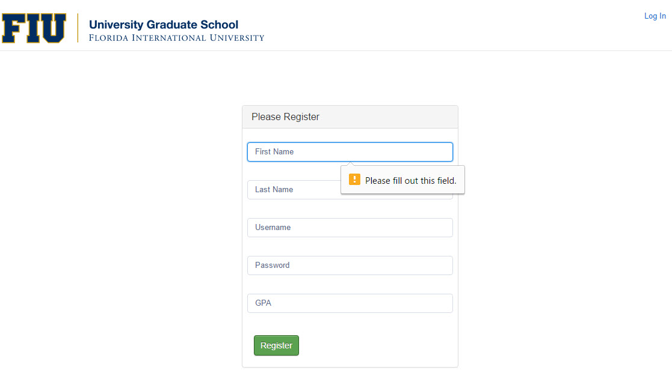
School of Computing & Information Sciences
Senior Project, 2017, Spring
Fellowship Management 1.0
Student: Alfredo Morales, Florida International University
Mentor: Mohsen Taheri, Florida International University
Instructor: Masoud Sadjadi, Florida International University
Problem
Can we create a web application in order to list and manage fellowships grants for graduate students?
Fellowships Management should empower graduate students to apply and re-create their opportunities in continuing their studies.
Current System
The system is ready to be used for graduate students. The applicants shall have access to a list of available fellowships and based on their necessities, they can apply for one or several fellowships.
Requirements
The system shall allow users, depending on their roles, to:
Create Fellowship
Remove Fellowship
Update Fellowship
Delete Fellowship
Create User
Remove User
Update User
Delete User
Apply for Fellowships
Un-apply for Fellowships,
Object Design
Solution
Our solution provides graduate students with a framework that helps break down complex decisions into smaller when searching and applying for desired fellowships.
Based on the product owner requirements this application is implemented using Apache, MySQL and PHP.
Implementation
Operating System:
Web Server:
Scripting Languages:
Database:
System Design
Screenshots
Verification
Verification and validation of some of the inputs are done on the app, which cause errors to appear as red text. For example, during Creation of a new User or Registration.
Summary
Fellowship Management puts a new spin on Fellowships Grants. It gives the user the flexibility to break down opportunities and to find the most efficient way to continue studying based on their necessities.
Acknowledgement
The material presented in this poster is based upon the work supported by Alfredo Morales. I am thankful to the help that I received from my group member, Winicius Siqueira, as well as the support received from Mohsen Taheri, David Driesbach.
Notes:
1

